Slide 1


Transform your Business with IoT
Pamela Cortez | Senior PM, Azure IoT
@AltaOhms
/in/pamelacortezhellotechie

Slide 2
Build end to end IoT Solutions
1. Transform your business with IoT
2. Connect devices to the cloud
3. Provision devices at scale
4. Understand IoT message processing, analytics, and business integration
5. Build the intelligent edge
6. Build IoT solutions with Azure IoT Central
Notes:
Transform your business with IoT
To start this series, we’ll explain how the Internet of Things (IoT) addresses the problems of efficiency, productivity, safety, and security. We’ll describe Azure IoT components and explain how you combine them to create value for enterprises, enabling digital feedback loops for solutions that extend beyond telemetry with analytics and edge solutions that provide real-time status.
Create an Azure dashboard and resource group.
Create an IoT hub using the Azure portal.
Examine features of Azure IoT Hub.
Create a device provisioning service and link it to your IoT hub.
Connect devices to the cloud
In this session, you’ll learn how to set up the development environment used throughout this series. We’ll cover how to connect an IoT device that includes temperature and humidity sensors to Azure. In the labs, you’ll configure a simulated device to connect to Azure IoT Hub. Then you’ll run the simulated device to send telemetry messages and verify that device telemetry is being received.
Provision devices at Scale
This portion of the workshop walks through a hypothetical asset-monitoring solution that requires IoT devices with sensors for tracking location, temperature, and pressure to be placed in product transport boxes. When a new box enters the system, it is equipped with the new IoT device. The device needs to be autoprovisioned to the IoT hub using Azure’s device provisioning service. When the box arrives, the sensor is removed from the box and needs to be “decommissioned” through the device provisioning service. You’ll learn how you can use the device provisioning service to enroll many devices automatically and securely using X.509 certificate authentication.
Understand IoT message processing analytics and business integration
Preventive maintenance is a key IoT scenario—detect that something is wrong before there is any damage. In this module, you’ll write code to send continuous telemetry to an IoT hub that will use Azure Stream Analytics and a built-in machine learning model to warn of anomalies. Using Power BI to visualize the data stream, you’ll create an event subscription within Azure IoT Hub to set up Azure Event Grid integration that will trigger a logic app to send an alert. We’ll also cover working with time series data using Azure Time Series Insights.
Build the intelligent edge
With the collection of large amounts of data and the need for urgent responses, you’ll want to bring the intelligence to the edge for processing data and only send the important data to the cloud. We’ll take a deep dive on using an Azure IoT Edge device as a gateway and you’ll learn the different scenarios where an IoT Edge device is on an enterprise network (needs proxy settings) or needs extended offline capabilities.
Build solutions with IoT Central
Designed to enable the easy monitoring and management of a fleet of devices, Azure IoT Central encompasses a range of underlying technologies that work together well but can be complicated to implement when many technologies are needed. These technologies include Azure IoT Hub, the Azure device provisioning service, Azure Maps, and others. We’ll also take a look at IoT Plug and Play to interact with a device's capabilities even without knowledge of the underlying device implementation.

Slide 3
Agenda
Why IoT
Top reasons for adopting IoT
Microsoft IoT:
Developers Choice: Building IoT Solutions.
DEMO: Getting started with Azure IoT Hub
DEMO: Getting started with Azure IoT Central
Security
Intelligent Edge
Scale
Resources
Live Q&A

Slide 4
Why IoT

Slide 5


What is IoT?
Digital world
Insights
Things
Actions
Physical world

Slide 6

What IoT is really about:
Deeper relationships
Customers
Employees
Employee input
Systems & experiences
Intelligent
More effective employees
More efficient ops
Customer signals
Product telemetry
Data & AI
Enabling a digital feedback loop
Operational data
Operations
Products
Better products
Notes:
What iOT is really about: Enabling a digital feedbackloop. Businesses want to evolve their operations, products, and how they interact with customers. By connecting devices and collecting data, it becomes possible to analyze that information to create new insights.
This lets companies make improvements to their business - from increasing operational efficiency to delivering better customer experiences and new revenue streams. A real-time connection enables new breakthrough levels of insight that in turn drive informed actions. For example that use cases earlier with a machine on the factory floor, we can analysis the data overtime to see what caused the failure or even help us change the process on how often the motor needs to be replace or update the regular matinene schedule, so there isn’t any disruptions when the assembly line at the factory is running.

Slide 7










Where does IoT come from?
The evolution of IoT and connected solutions
Emerging
Connected Environments
Future
Connected ecosystems
Today
Connected Assets
Actions
Agility 40-50% faster speed to market
Productivity 20-30% higher workforce productivity
Stability up to 60% fewer IT errors and less rework
Performance 12-20% additional earnings before interest and taxes
Notes:
So, what exactly is the impact of getting data from all these things from the edge and putting them together? There are 4 major benefits:
Agility. In the cycle of development, when you speed up the processes and infrastructure, it means you can get your products and services to market more quickly. More than half the companies using IoT have seen such results.
Productivity. If you make real-time information available, you eliminate the delay of waiting that comes with collecting and analyzing information. That helps make people more productive.
Stability. IoT offers preventative maintenance through its insight. Such insight wasn't available before. Having this insight can help identify weaknesses in advance of their becoming serious issues.
Performance. The better the information used for analysis, the better decisions people make, which can lead to higher profits. Faster speed to market with products can also increase profitability.
[1] Source: https://www.zdnet.com/article/iot-to-drive-growth-in-connected-devices-through-2022-cisco/
[2] Source: Gartner
[3] Source: Deloitte
[4] Source: IDC FutureScape

Slide 8
Top reasons for adopting IoT: Productivity and security
Reasons for IoT adoption
By industry
Safety and security (e.g. workplace safety, employee safety, IT security)
Operations optimization
Quality assurance (e.g. ensuring quality of product/staff processes)
Employee productivity
Manufacturing
Power & Utilities
47%
Plant safety and security | 36%
Worker safety | 25%
IT security | 40%
Employee safety | 30%
Workplace safety | 26%
47%
45%
Healthcare
Oil & Gas
IT security | 44%
Workplace safety | 39%
Employee safety | 37%
IT security | 41%
Employee safety | 31%
Workplace safety | 31%
43%
Top challenges to adoption
Retail
Surveillance and security | 40%
The complexity of scaling IoT and technical challenges still impede further adoption, even more than security challenges. Organizations need to undergo a culture change and prioritize investing in staff that can implement and maintain IoT solutions.
Notes:
IoT spans many different industries and use cases. It has been estimated 41.6 billion connected devices by 2025, according to IDC. Microsoft recently does an annual report called IoT Signals to spotlight IoT adoption, challenges, trends, and opportunities. So why do companies adopt IoT? Out of that research, we found that the top reasons for iot adoption. Leading the way was safety and security as in workplace safety, employee safety, and so on. It tied with operational optimization, illustrating the expectations of organizations by digitally transforming pieces of their infrastructure. Quality assurance, next on the list, refers to human resources and equipment. Employee productivity ranks fourth, and ties well with the top three in that if you provide a safe environment with quality assurance in place, your people will get more done and optimize operations.

Slide 9




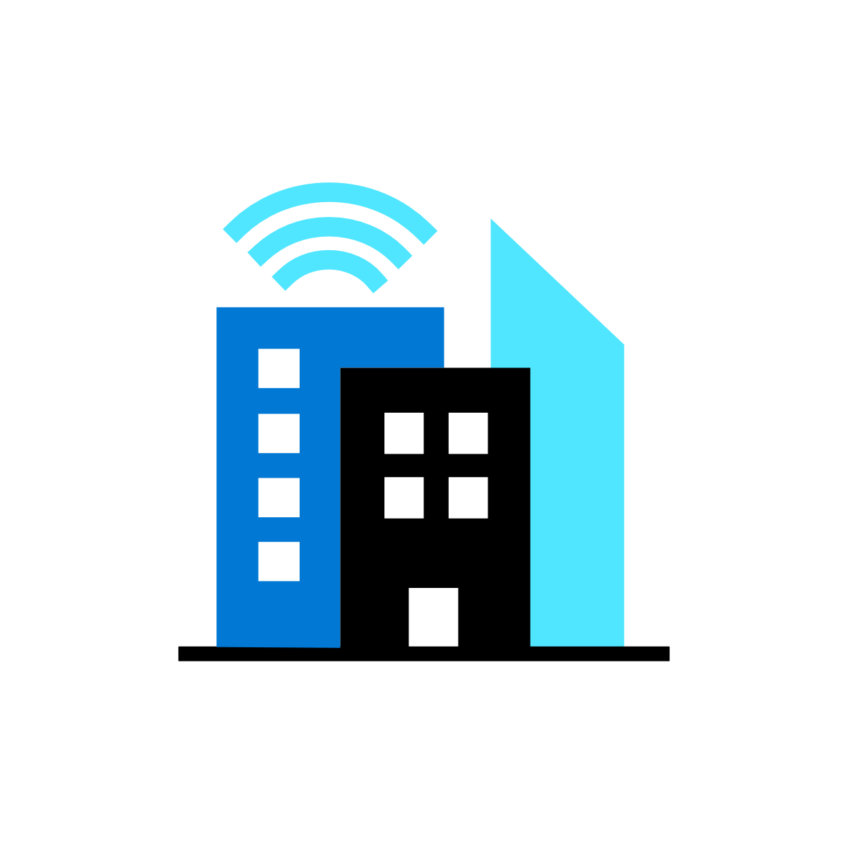

Microsoft’s comprehensive IoT product portfolio
→ aka.ms/mslearniot
Azure IoT priority verticals
Manufacturing | Retail | Agriculture | Energy | Smart Cities | Healthcare | Transportation
Azure IoT Central
(SaaS)
Azure IoT Reference Architecture & Accelerators (PaaS)
Dynamics Connected
Field Service
(SaaS)
Azure IoT Solutions
Azure IoT Hub
Azure IoT Hub Device Provisioning Service
Azure Digital Twins
Azure Time Series Insights
Azure Maps
Azure Stream Analytics
Azure Cosmos DB
Azure AI
Azure Cognitive Services
Azure ML
Azure Logic Apps
Azure Active Directory
Azure Monitor
Azure DevOps
Power BI
Azure Data Share
Azure Spatial Anchors
Azure Defender
for IoT
Azure Services for IoT
Azure RTOS
Azure Sphere
Azure IoT Device SDK
Azure IoT Edge
Azure Stack Edge
Windows IoT
Azure Certified for IoT—Device Catalog
Azure Stream Analytics
Azure Storage
Azure ML
Azure SQL
Azure Functions
Azure Cognitive Services
IoT & Edge
Device Support
Notes:
Our foundational technology investments are the underpinning for all of this.
Simply building IoT solutions and reducing the complexity of building end to end solutions. Plus connect to the rest of your business.
We have products and services for both the device and cloud side. Plus, products with Azure IoT Central to help you build an IoT solution quickly without the need of any cloud solution development skills required.

Slide 10
Microsoft IoT

Slide 11
Azure IoT helps you transform your business
Quickly turn your vision into reality with secure, scalable, and open, edge-to-cloud IoT solutions
Develop with choice
Prepare for future innovation
Secure data everywhere
Power the Edge
Scale globally
Notes:
Azure IoT is a collection of Microsoft-managed cloud services that connect, monitor, and control billions of IoT assets. With it you can quickly turn your vision for a connected future into reality with secure, scalable, and complete, edge-to-cloud IoT solutions. We’ve broken down the platform into five primary pillars:
Develop with choice
Simple tools, simple templates, and open source. You can build open and flexible IoT solutions on your terms. Get leading device management, cloud integration and choice across fully managed applications or IoT platform services.
Prepare for future innovation
You can build on a platform and with an ecosystem with that is continuously enhancing data, AI, and analytics solutions. Integrate into your existing systems, launch into new opportunities. There’s so much potential here.
Secure data everywhere
With Azure IoT, you can trust your data is more secured from endpoints to the cloud. That’s because we partner with the most proactive leader in IoT security with the largest portfolio of regulatory and compliance certifications in the industry.
Power the Edge
Azure IoT lets you move your AI and business workloads to the edge. This lets you react with more agility, operate more reliably, and spend less time transmitting to the cloud.
Scale globally
Scalability is always an important issue. With Azure IoT, you can unlock the largest IoT ecosystem global to scale, wherever and whenever you are ready to grow.

Slide 12
Develop with choice
Prepare for future innovation
Secure data everywhere
Power the Edge
Scale globally
Azure IoT Central
Azure IoT Hub
Digital Twins
Notes:
Let’s look deeper at the platform. We start with develop with choice.

Slide 13



Develop with choice
Digital Twins
Azure IoT Central
Azure IoT Hub
The easiest and most cost-effective way to connect and manage devices at scale, and time to results.
Enable highly secure, flexible and reliable communication from the cloud to the edge.
Create comprehensive digital models of entire environments.³
1000+ Azure IoT Devices certified¹
150 billion messages per month via IoT Hub²
Gartner includes Microsoft as a Digital-Twin-Enabled Application Provider³
1 Placeholder Source; 2 Placeholder Source; 3 Gartner: Market Guide for Digital Twin Portfolios and Enabling Technologies (Jan 2020)
Notes:
Azure IoT Central is the easiest and most cost-effective way to connect and manage devices at scale. It connects your IoT devices to the cloud faster than any other platform. You can find new devices matched to your solution in the Azure Certified for IoT device catalog. Also, we understand how hard it is to keep devices connected and healthy. Azure IoT Central lets you reconfigure and update devices with centralized device management. In addition, the connectors and extensibility APIs bridge the gap between your business applications and IoT solution.
Azure IoT Hub is a Platform as a Service. With it you can do the following:
Establish bi-directional communication with billions of IoT devices
Enhance security with per device authentication
Provision devices at scale with IoT Hub Device Provisioning Service
Manage devices at scale with device management
Use multi-language and open source SDKs
A Digital Twin (DT) is a dynamic digital representation of a physical piece of equipment, or thing, and its associated environment. Every DT has a dynamic data model containing only a few, or even thousands, of data attributes of the physical thing or system it represents. Attributes are associated with sensors that are measuring temperature, pressure, and other variables and associated physics in order to represent real-world operating conditions as well as static values like the installation date or OEM. Azure Digital Twins is the development platform for IoT solutions that model the real world.

Slide 14

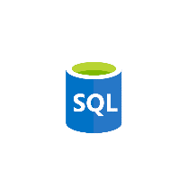


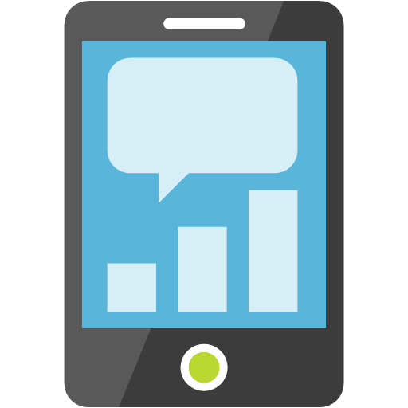






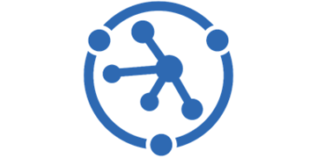

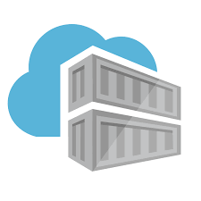



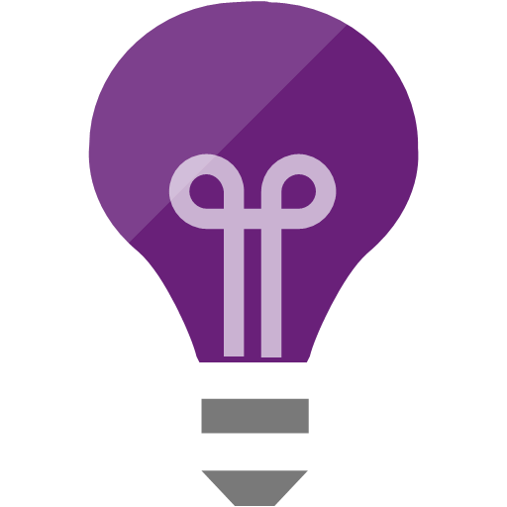

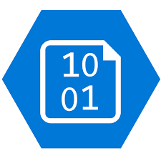

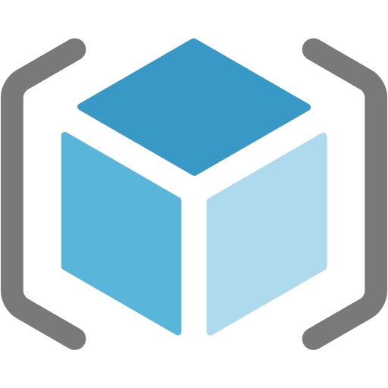


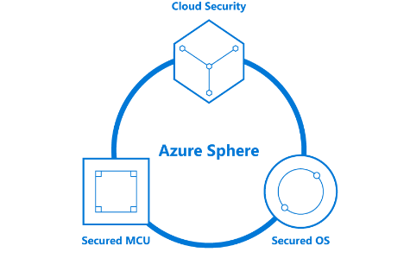
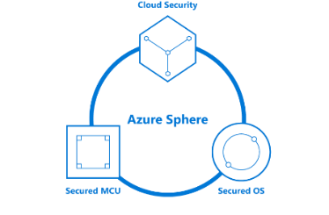
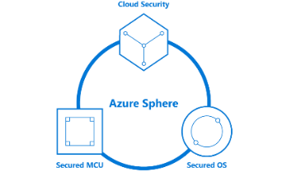




Your options for building IoT solutions
Option 1. Build from the ground up
THINGS
INSIGHTS
ACTION
Gain real time insights and improve business processes
Identify patterns in data, automate rules & alerts
Optimize operations, increase profitability, & create more compelling business models
Manage
View and manage solutions
Azure IoT Device SDK
3rd Party Industry specific sensors & devices
(RTOS, Linux, Windows, Android, iOS)
Functions
SQL Azure
Web Apps
Power BI
Mobile Apps
Edge Modules:
Protocol Adaptation
Functions
Stream Analytics
Machine Learning
AI
Event Hub
Maps
IoT Hub
PowerApps
Web Apps
Azure IoT Edge
Device Provisioning Service
Time Series Insights
Key Vault
Business Integration
Connect to business apps & services
Container
Registry
Azure Stream
Analytics
Cosmos DB
Data Explorer
Application Insights
Dynamics 365
Kubernetes Service
Office 365
Azure Sphere
Compute (VMs)
Content Delivery Network
Storage
Resource Manager (ARM)
3rd Party applications
Domain Name System
Microsoft Flow
Secured MCU
Secured OS
Cloud Security
Service Bus
Front Door
Integrated view for CISO & SecOps personas to review enterprise security posture, including IoT solutions.
Holistic view of IoT solution security posture for DevOps and IoT solution managers to review and manage day to day security status
Azure Defender for IoT
Notes:
Azure IoT Hub and Azure Digital Twins provide the building blocks for companies to construct customized IoT solutions
The right fit for businesses with cloud solution and device expertise (in-house or through partnerships) who want to fine-tune their services with a high degree of control and customization

Slide 15
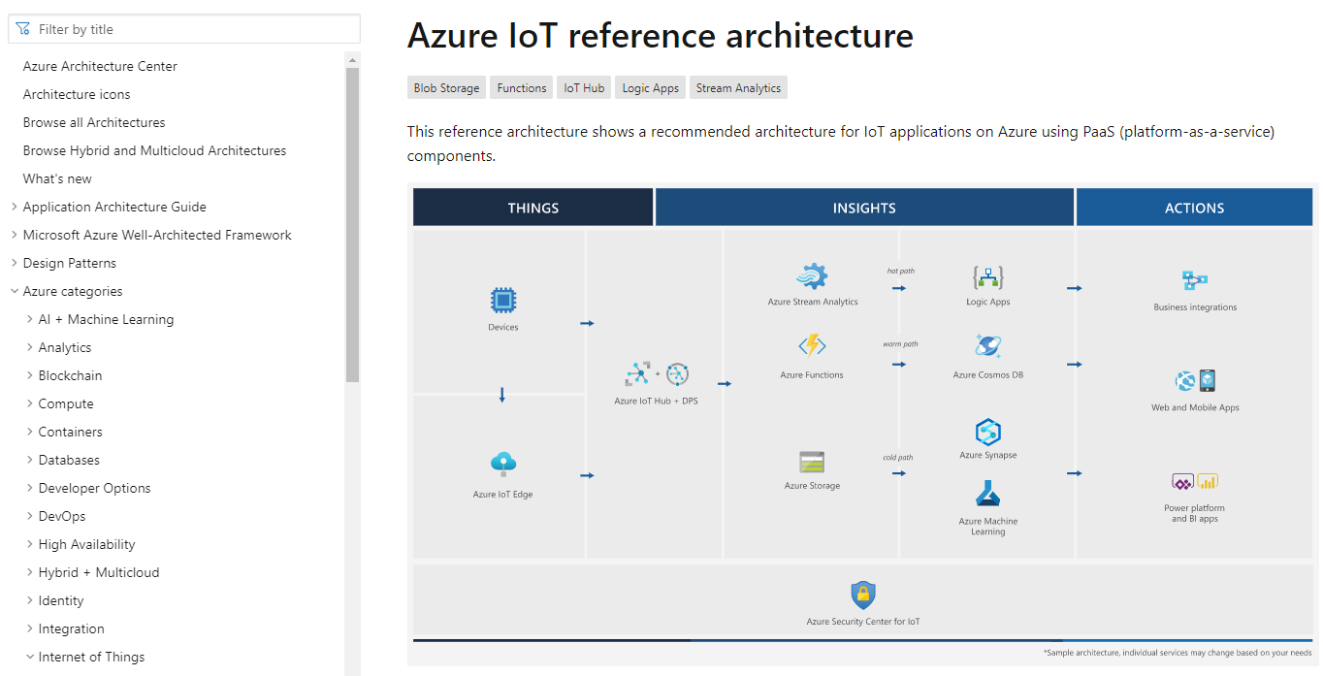

Develop with choice
https://aka.ms/iotrefarchitecture
Digital Twins
Azure IoT Central
Azure IoT Hub
The easiest and most cost-effective way to connect and manage devices at scale, and time to results.
Enable highly secure, flexible and reliable communication from the cloud to the edge.
Create comprehensive digital models of entire environments.³
1000+ Azure IoT Devices certified¹
150 billion messages per month via IoT Hub²
Gartner includes Microsoft as a Digital-Twin-Enabled Application Provider³
1 Placeholder Source; 2 Placeholder Source; 3 Gartner: Market Guide for Digital Twin Portfolios and Enabling Technologies (Jan 2020)
Notes:
Azure IoT Central is the easiest and most cost-effective way to connect and manage devices at scale. It connects your IoT devices to the cloud faster than any other platform. You can find new devices matched to your solution in the Azure Certified for IoT device catalog. Also, we understand how hard it is to keep devices connected and healthy. Azure IoT Central lets you reconfigure and update devices with centralized device management. In addition, the connectors and extensibility APIs bridge the gap between your business applications and IoT—a direct connection between IoT data and your decision makers.
Azure IoT Hub is a Platform as a Service. With it you can do the following:
Establish bi-directional communication with billions of IoT devices
Enhance security with per device authentication
Provision devices at scale with IoT Hub Device Provisioning Service
Manage devices at scale with device management
Use multi-language and open source SDKs
A Digital Twin (DT) is a dynamic digital representation of a physical piece of equipment, or thing, and its associated environment. Every DT has a dynamic data model containing only a few, or even thousands, of data attributes of the physical thing or system it represents. Attributes are associated with sensors that are measuring temperature, pressure, and other variables and associated physics in order to represent real-world operating conditions as well as static values like the installation date or OEM. Azure Digital Twins is the development platform for next-generation IoT solutions that model the real world.
<click>
Our lab later today will focus on using the Azure IoT Hub platform.

Slide 16

Your options for building IoT solutions
2. Build with a fully managed IoT app platform
THINGS
INSIGHTS
ACTION
Gain real time insights and improve business processes
Identify patterns in data, automate rules & alerts
Optimize operations, increase profitability, & create more compelling business models
Manage
View and manage solutions
Azure IoT Device SDK
3rd Party Industry specific sensors & devices
(RTOS, Linux, Windows, Android, iOS)
Azure IoT Central
Build with Azure IoT Central, our IoT App Platform
Functions
SQL Azure
Web Apps
Power BI
Mobile Apps
Simplify production-ready IoT solution development
Simplify setup, reduce management burden, operational costs, and overhead of a typical IoT project.
Bring solutions to market faster, while staying focused on your customers
Edge Modules:
Protocol Adaptation
Functions
Stream Analytics
Machine Learning
AI
Event Hub
Maps
IoT Hub
PowerApps
Web Apps
Azure IoT Edge
Device Provisioning Service
Time Series Insights
Key Vault
Business Integration
Connect to business apps & services
Container
Registry
Azure Stream
Analytics
Cosmos DB
Data Explorer
Highly secure
Enterprise-grade
Predictable pricing
Industry-focused
Application Insights
Dynamics 365
Kubernetes Service
Azure Sphere
Compute (VMs)
Office 365
Content Delivery Network
Storage
Resource Manager (ARM)
3rd Party applications
Domain Name System
Microsoft Flow
Secured MCU
Secured OS
Cloud Security
Service Bus
Front Door
Integrated view for CISO & SecOps personas to review enterprise security posture, including IoT solutions.
Holistic view of IoT solution security posture for DevOps and IoT solution managers to review and manage day to day security status
Azure Defender for IoT
Notes:
Azure IoT Central enables companies to get started quickly building IoT applications with a fully-managed IoT solution offering.
The right fit for businesses that do not wish to dedicate extensive resources to system architecture and want to select a solution that provides predictable pricing and the ability to customize branding, device types, data management and user roles.
Questions to ask yourself on which choice to take:
1) Expertise: How proficient are you with building cloud solutions
2) Control: What elements of my solution do I want to customize
3) Pricing: What structure best fits your needs?

Slide 17
Demo 1: Getting started with IoT Hub Demo 2: Getting started with Azure IoT Central

Slide 18
Prepare for future innovation
Develop with choice
Secure data everywhere
Power the Edge
Scale globally
Azure Time Series Insights
Notes:
Next, lets talk about preparing for future innovation.

Slide 19
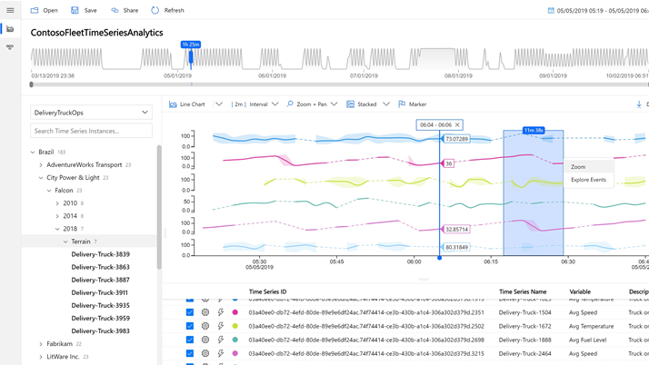

Azure Time Series Insights (TSI)
A serverless, fully-managed Platform as a Service (PaaS) solution built for IoT
Ingest, process, store, and query highly contextualized, time-series-optimized, IoT-scale data
Built-in rich user experience for ad-hoc queries and exploration
Rich analytics APIs for ad-hoc exploration and operational intelligence
JavaScript control library for building custom analytics apps on the TSI platform
Notes:
Session 4: Understand IoT message processing, analytics, and business integration
Azure Time Series Insights (TSI) is a serverless, fully-managed Platform as a Service (PaaS) solution built for IoT. Features include the following:
Highly contextualized, time-series-optimized, IoT-scale data that can be Ingested, processed, stored, and queryed
Built-in rich User Experience for ad-hoc queries and exploration
Rich analytics APIs for ad-hoc exploration and operational intelligence
A JavaScript control library for building custom analytics apps on the TSI platform
Remember that option 1 path with building with our platform services?

Slide 20
Secure data everywhere
Develop with choice
Prepare for future innovation
Power the Edge
Scale globally
Azure Sentinel
Azure Defender for IoT
Azure Sphere
Notes:
Next, we have security.

Slide 21

Azure IoT security
End-to-end threat protection for IoT solutions
Azure Defender for IoT
Azure Sentinel
Azure Sphere
Azure Sphere Guardian
Azure IoT Central
Azure IoT Edge
Azure IoT Hub
Notes:
Azure offers IoT security with options for end-to-end protection for your IoT solution. Microsoft’s integrated hardware, software, and cloud services work seamlessly together and deliver active security by default.
Here are different components of Azure’s comprehensive security features:
Azure Defender for IoT
Protects unmanaged IoT/OT devices with agentless asset discovery, vulnerability management, and threat detection
SKIP: Azure Sentinel
Provides intelligent security analytics for your entire enterprise with the industry’s first cloud-native SIEM/SOAR
Azure Sphere
Offers a comprehensive IoT security solution—including hardware, OS, and cloud components
Azure Sphere Guardian
Increases brownfield security posture paired with existing equipment to enable secured connectivity
Azure IoT Central
Reduces risk by using security posture management, threat monitoring
Azure IoT Edge
Ensures devices have the right software and that only authorized edge devices can communicate with one another
Azure IoT Hub
Enables a more secure and reliable communication between your IoT application and the devices it manages

Slide 22
Azure Sphere
An end-to-end solution for securely connecting existing equipment and creating new IoT devices with built-in security
Azure Sphere operating system
Azure Sphere certified chips
Azure Sphere operating system (OS)
Azure Sphere security service
Ongoing OS and security updates
Azure Sphere certified chips
Ongoing support
Azure Sphere security service
Notes:
Azure Sphere brings more than 10 years of security and OS updates delivered directly to each device by Microsoft. It’s an end-to-end solution for securing IoT devices. You can use it to secure your existing mission-critical equipment, or to build net-new devices that are secured from the start. So device manufacturers can focus their energy on the applications and features they want to deliver to customers, and not the rigorous work it takes to manage a secured operating system.
Features include:
Security support for any device
Ongoing OS and security updates
Edge workloads protected by enclaves
Threat monitoring and mitigation across devices

Slide 23
Power the Edge
Develop with choice
Prepare for future innovation
Secure data everywhere
Scale globally
Azure IoT Edge
Notes:
Power to the edge includes different components of Azure IoT Edge.

Slide 24

IoT Edge
Run Azure AI, Azure Services and Custom Services directly on IoT devices
Offload AI and analytics workloads to the edge
Operate offline or with intermittent connectivity
Respond in real-time since analytics happen at the edge
Open source, cross platform, container-based edge runtime
Simplify development using language skills you already have
Notes:
Azure IoT Edge lets you extend cloud intelligence to devices. It addresses the risks that are inherent when moving data and analytics to the edge, with security standards that balance flexibility for different deployment scenarios with the protection that one might expect from all Azure services. Azure IoT Edge runs on various makes and models of hardware, supports several operating systems, and applies to diverse deployment scenarios. And it’s an extensible security framework based on well-grounded principles that are designed for scale.
Azure IoT Edge modules are units of execution, implemented as Docker compatible containers, that run your business logic at the edge.
Azure IoT Edge runtime enables custom and cloud logic on IoT Edge devices.
Azure IoT Edge cloud interface enables remote monitoring and management.

Slide 25
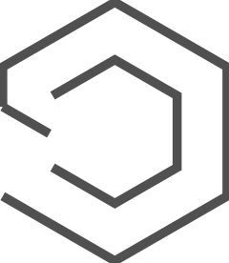
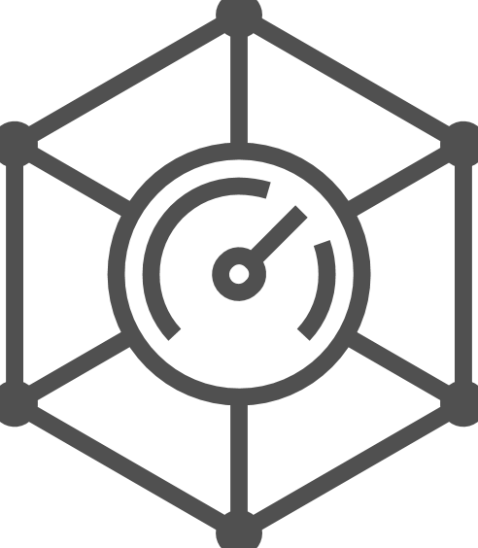
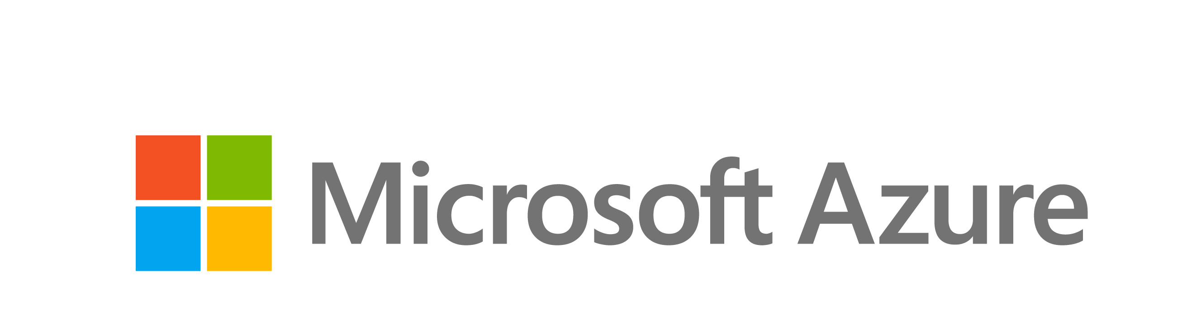
Bringing intelligence to any asset Silicon to Service
Azure
IoT Hub
Azure
IoT Edge
Azure
IoT Central
Azure Digital
Twins
INTELLIGENT CLOUD
MCU-Class
Sensors/Actuators
MPU-class
Server-class
Hybrid server,
Hyper converged infra
AZURE SPHERE, Azure RTOS, Embedded C SDK
Peerless security for microcontroller-based devices
WINDOWS 10 IoT, Linux, Azure RTOS, Azure IoT Edge, Device SDKs
The power of Windows or Linux on small footprint enterprise-grade edge devices.
Kiosks, industrial HMIs, point-of-sale, medical equipment, gateways, and more
WINDOWS SERVER IoT
For the most demanding edge computing workloads
AZURE STACK, Azure IoT Edge
An extension of Azure to consistently build and run hybrid applications across cloud boundaries
INTELLIGENT EDGE
Notes:
An intelligent edge is a set of connected systems and devices that gather and analyze data closest to where users/data reside to deliver real-time insights and experiences that are highly responsive and contextually aware. The intelligent cloud exists to ingest, store, analyze and route data and derived insights in a public cloud environment that provides scale, value and security to customers.
MCU Sensors + control
MPU Microprocessors
Going forward, companies will need a ubiquitous computing fabric from the cloud to the edge. That's what we're building with Azure.
Azure is being built as the world's computer. It already has 50-plus regions, 70-plus certifications, more regions and more certifications than any other public cloud. And that's so that we can meet the real world needs of customers, their digitally sovereignty needs, their regulatory needs.
But we're not stopping there. In fact, as computing spreads, as there is need for computing at the edge, we are building out Azure, Azure Sphere, Azure IoT edge, Windows 10 IoT, Windows, Windows Server, as this one computing fabric.
We are talking about computing from the smallest chip to the largest server. We think about it as a continuum of devices that we can design, build and sell together.

Slide 26

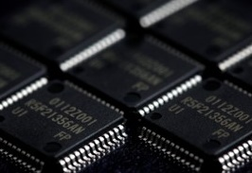
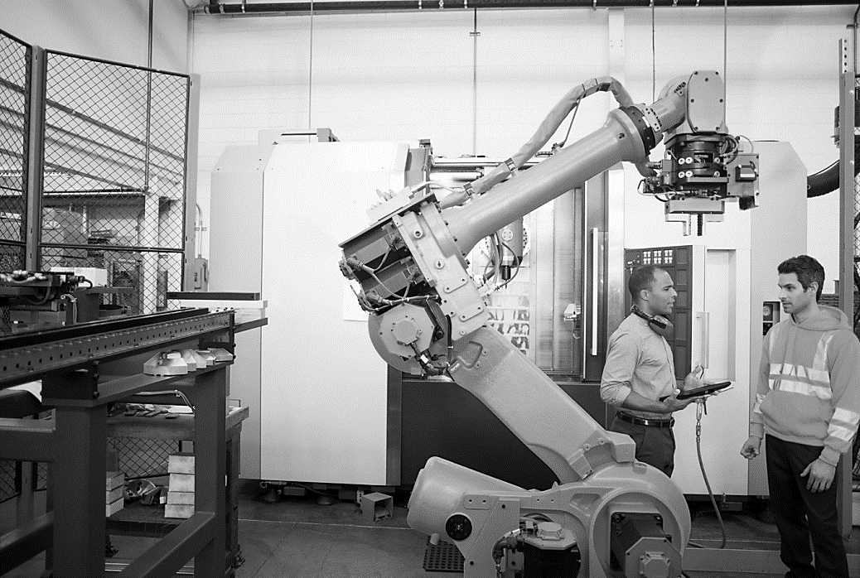
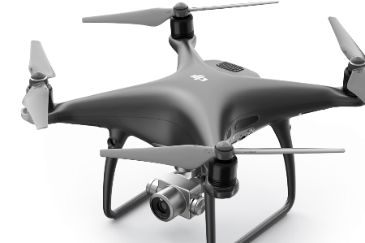
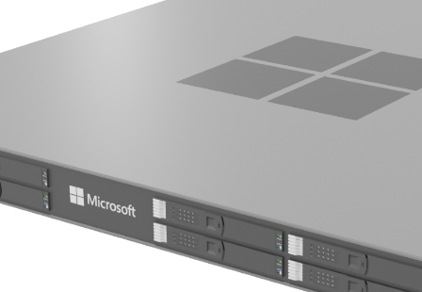
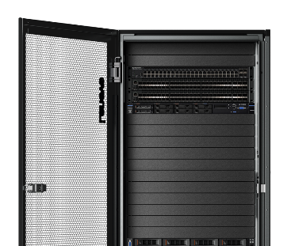
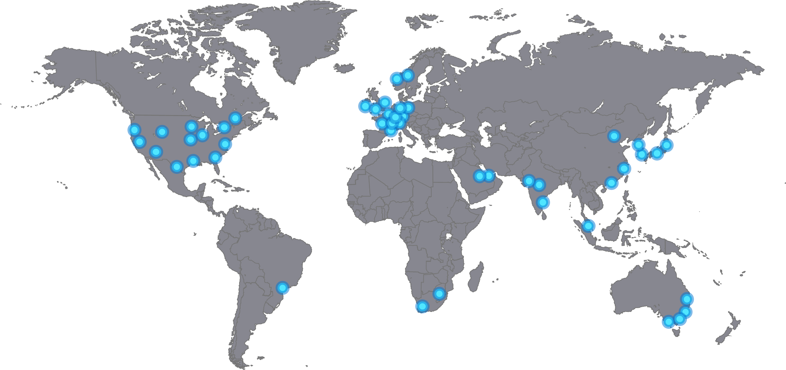
Intelligent Edge to Intelligent Cloud
Intelligent Edge Story
Sensors + control
Sensors to interactive
Integrated platform
Global scale processing
MCU
IoT Devices
Edge Devices
Edge Appliances
Edge Cloud
Hyperscale cloud
Inferencing
Inferencing
Inferencing
Inferencing
Inferencing
Inferencing
Training
Training
Training
Training
Training
Training
Data
Data
Data
Data
Data
Data
Sample Workload | Limited: Sensor Data, Video and Image Capture, Anomaly Detection, PdM Local/Global Notification |  |  | Advanced: Sensor Data, Video and Image Capture, Anomaly Detection, PdM, AI/ML Workloads Live Video Analytics (LVA) Local/Global Notification |  |  | Big Data and Deep Learning Model Training Limitless: Sensor Data, Video and Image Capture, Anomaly Detection, PdM, AI/ML Workloads Live Video Analytics (LVA) Local/Global Notification
What runs the model | MCU | SoC SoM | Hardware Accelerated NNA | Multi-ARM CPU | x64 CPU | CPU + GPU | CPU + GPU | CPU, GPU or FPGA
Example | Azure Sphere Appliance | Mobile Phones IP Cameras | Mobile Phones VAIDK | Video Gateway DVR | Industrial PC | Azure Stack Edge | Azure Stack Hub Azure Stack Edge Cluster | DSVM / ACI / AKS / Batch AI
Less aggregated data and insights
Full spectrum of data collection and aggregation using Azure Storage
More aggregated data and insights
Less AI functionality
Azure AI functionality availability based on computational resources
Most AI functionality
Notes:
Looking over this slide it is a bit of an eye chart. But it simply identifies that there are a lot of different categories that can be used in the intelligent system. From the left side you have devices that require less power, but also have less AI functionality and as we travel to the right side we get more AI functionality…but also more power and space is required.

Slide 27
Scale globally
Develop with choice
Prepare for future innovation
Secure data everywhere
Power the Edge
Partner network
Azure Marketplace
Datacenters
Notes:
Lastly, we have scale globally.

Slide 28

Microsoft’s comprehensive IoT product portfolio
Azure IoT priority verticals
Manufacturing
Retail
Agriculture
Energy
Smart Places
Healthcare
Transportation
Azure IoT Central
Dynamics Connected Field Service and Connected Store
Azure IoT solutions
Azure Defender
for IoT
Azure IoT Hub
Azure IoT Hub Device Provisioning Service
Azure Digital Twins
Azure Time Series Insights
Azure Maps
Azure Stream Analytics
Azure Cosmos DB
Azure AI
Azure Cognitive Services
Azure ML
Azure Logic Apps
Azure Active Directory
Azure Monitor
Azure DevOps
Power BI
Azure Data Share
Azure Spatial Anchors
Azure
Services for IoT
Azure RTOS
Azure Sphere
Azure IoT Device SDK
Azure IoT Edge
Azure Stack Edge
Windows IoT
Azure Certified for IoT—Device Catalog
Azure Stream Analytics
Azure Storage
Azure ML
Azure SQL
Azure Functions
Azure Cognitive Services
IoT & Edge
device support
Notes:
Microsoft has the industry-leading portfolio of services that help customers easily create IoT solutions spanning the intelligent cloud and edge based on their needs—from ready to use Software as a Service (SaaS) applications to custom solutions across device, cloud, and integration services.
Azure IoT is helping our customers make things happen at every level of their organization’s digital transformation by providing the most comprehensive portfolio for IoT from the edge to the cloud. You get enterprise-ready solutions, predictable costs and timelines, and the largest network of IoT partners across industry. You not only put your organization in position for evolution with improved efficiency and improved margins, but with advanced analytics and AI, Azure IoT puts your organization in position for revolution to disrupt, create new revenue streams, and stay ahead of the pack.

Slide 29
Resources
Notes:
ELP videos/presentation decks, MS Learn and Learn Paths, Instructor Led Training options, AZ220 Study Guide blog, IoT Demo GitHub and ultimately encouraging people to sign up for the 30 Days to Learn it challenge to earn 50% off the certification.

Slide 30

30 Days to Learn Cloud Skills Challenge
’30 Days to Learn it’ offers a time-bound, personalized, Cloud Skills Challenge that is built upon Microsoft Learn. It is designed to help developers build in-demand skills that advance their career, while preparing them to earn the Microsoft Certification for the Azure IoT Developer (AZ220) exam.
https://aka.ms/30DaysCSC/IoT
Notes:
ELP videos/presentation decks, MS Learn and Learn Paths, Instructor Led Training options, AZ220 Study Guide blog, IoT Demo GitHub and ultimately encouraging people to sign up for the 30 Days to Learn it challenge to earn 50% off the certification.
Aka.ms/30dayscsc

Slide 31
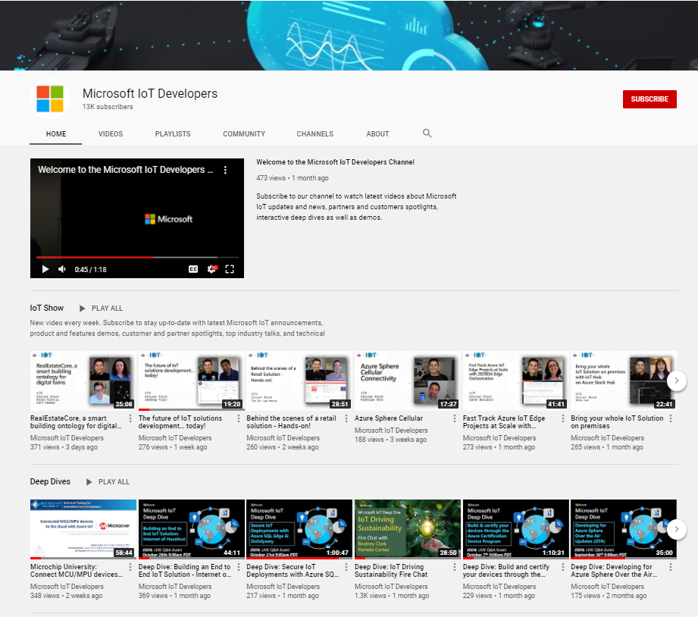
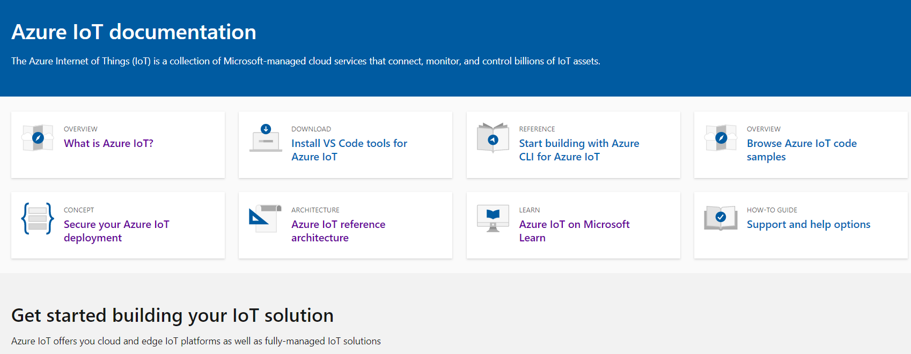
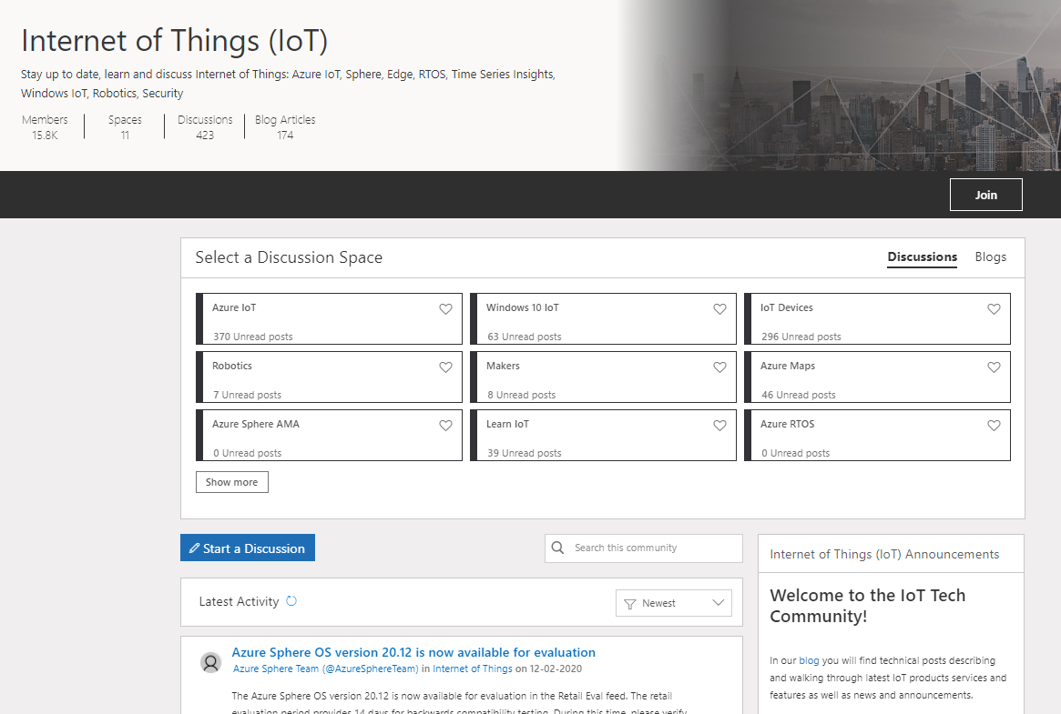
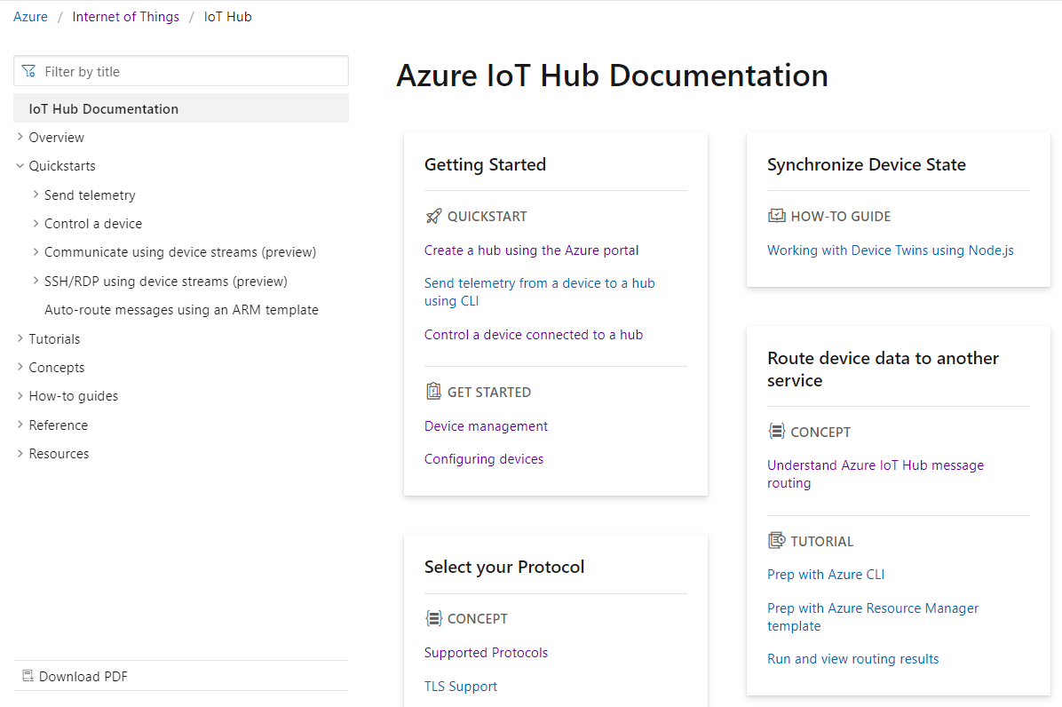

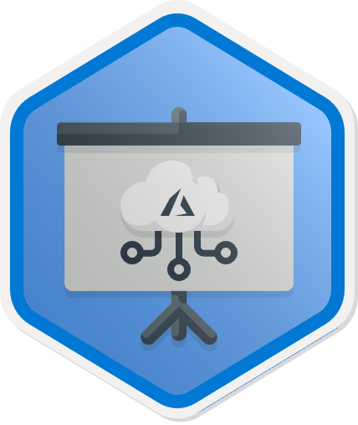
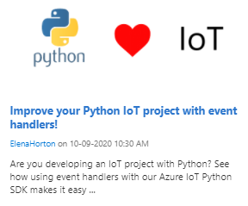
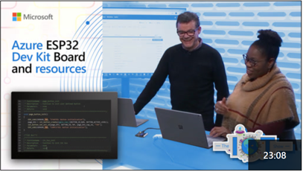
Start upskilling on Azure IoT today!
Hands on Learning | Watch | Discover and Discuss | Get Started Building
Microsoft Learn | Microsoft IoT Developers Channel | IoT Tech Community | Azure IoT Docs
https://aka.ms/mslearniot | https://aka.ms/msiotdevs | https://aka.ms/iottechcommunity | https://docs.microsoft.com/en-us/azure/iot-fundamentals/
MS Learn is the go-to site for self-paced, step-by-step learning. We offer over 40+ individual learn modules covering products such as Azure IoT Hub, IoT Edge, Digital Twins, and more. | Watch and learn about our products! View Deep Dives for deep technical learning. | Check out the blog to find technical posts describing and walking through latest IoT products services and features as well as news and announcements. | Check out the quick starts, how-to guides, and tutorials on Azure IoT Docs to learn how to build your IoT solutions.
https://aka.ms/IntroAzureIoTLearningPath
Notes:
Additionally, MS Learn offers 8 Learning Paths designed to help with certification exam prep as well as deeper concepts targeted at different roles including IoT developer, data engineer, solution architect, and administrator.
ELP videos/presentation decks, MS Learn and Learn Paths, Instructor Led Training options, AZ220 Study Guide blog, IoT Demo GitHub and ultimately encouraging people to sign up for the 30 Days to Learn it challenge to earn 50% off the certification.
Aka.ms/30dayscsc

Slide 32
Live Q&A Thank you! IoT Arch Reference: https://aka.ms/iotrefarchitecture Azure Account Signup: https://aka.ms/get-started-azure-2021 Azure IoT Central: https://apps.azureiotcentral.com/myapps Cloud Skills Challenge: https://aka.ms/30DaysCSC/IoT MS Learn: https://aka.ms/mslearniot MSFT IoT Developer Video Channel: https://aka.ms/msiotdevs IoT Tech Community: https://aka.ms/iottechcommunity Azure IoT Docs: https://docs.microsoft.com/en-us/azure/iot-fundamentals/
Notes:
ELP videos/presentation decks, MS Learn and Learn Paths, Instructor Led Training options, AZ220 Study Guide blog, IoT Demo GitHub and ultimately encouraging people to sign up for the 30 Days to Learn it challenge to earn 50% off the certification.

